Slide 1

RESTful APIs built in ASP.NET Core
@schneidenbach
Spencer Schneidenbach

Slide 2
Why?
@schneidenbach
Notes:
As an integrator, I see a lot of APIs that are good. I see far more that are bad. I’ve seen good SOAP APIs and bad ”REST” APIs.

Slide 3
API Design is UX for Developers
@schneidenbach
Notes:
Think about the business you’re in. Think about the services your business could provide to external consumers if you have an API.
Now think about your competition. A good API can means the difference between a lead and a customer.

Slide 4
This quote sums it up nicely
If you don’t make usability a priority, you’ll never have to worry about scalability.
-Kirsten Hunter @synedra
@schneidenbach

Slide 5


@schneidenbach

Slide 6
Simple != Easy
@schneidenbach
Notes:
Simple means simple for your users. Think about the effort put into creating a user interface that’s easy to use.
Making it easy for developers to consume your API is not a trivial task. Requires lots of thinking, research, and design. Not to mention good documentation!

Slide 7
There’s No Silver Bullet
@schneidenbach
Notes:
There’s no silver bullet, or one answer, to your API problems. Sometimes you’re limited by scalability.

Slide 8
What is REST?
Representational State Transfer
@schneidenbach
Notes:
It’s the architecture of the web

Slide 9
The Six Constraints of REST
Client-Server
Cacheable
Stateless
Layered
Code on Demand
(optional)
Uniform Interface
@schneidenbach

Slide 10
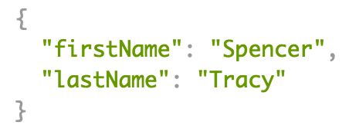
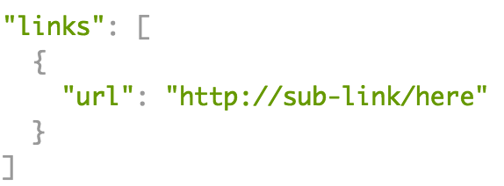
Uniform Interface constraint
GET /employees/1234
Content-Type:
application/json
PUT /employees/1234
Resource identification
Resource manipulation with representations
Self-descriptive
Hypermedia as the engine of application state (HATEOAS)
@schneidenbach

Slide 11
What is a RESTful API?
RESTful API == an API that follows REST architecture
Term has been sort of co-opted
REST != JSON
REST != HTTP
Lots of people say “REST API” when they really mean HTTP JSON API
@schneidenbach

Slide 12
Pragmatic REST
RESTful API != Good API
@schneidenbach

Slide 13
Do what makes sense. Throw out the rest.
Is that vague enough for you?
@schneidenbach

Slide 14
API Design Process
Design
Implement
Document
Maintain
@schneidenbach

Slide 15

Designing your RESTful API
I HAVE ONE RULE…
okay I actually have two rules
@schneidenbach

Slide 16
KISS (or, Keep it Simple, Stupid)
@schneidenbach

Slide 17
KISS
Don’t be creative.
Provide what is necessary – no more, no less.
Don’t let your specific implementations leak if they are hard to use or understand.
@schneidenbach
Notes:
Error codes/API structure/HTTP principles (GET vs POST)

Slide 18
Second big rule – Be Consistent
Be consistent with accepted best practices.
Be consistent with yourself.
@schneidenbach
Notes:
Error codes/API structure/HTTP principles (GET vs POST)

